Slide 1
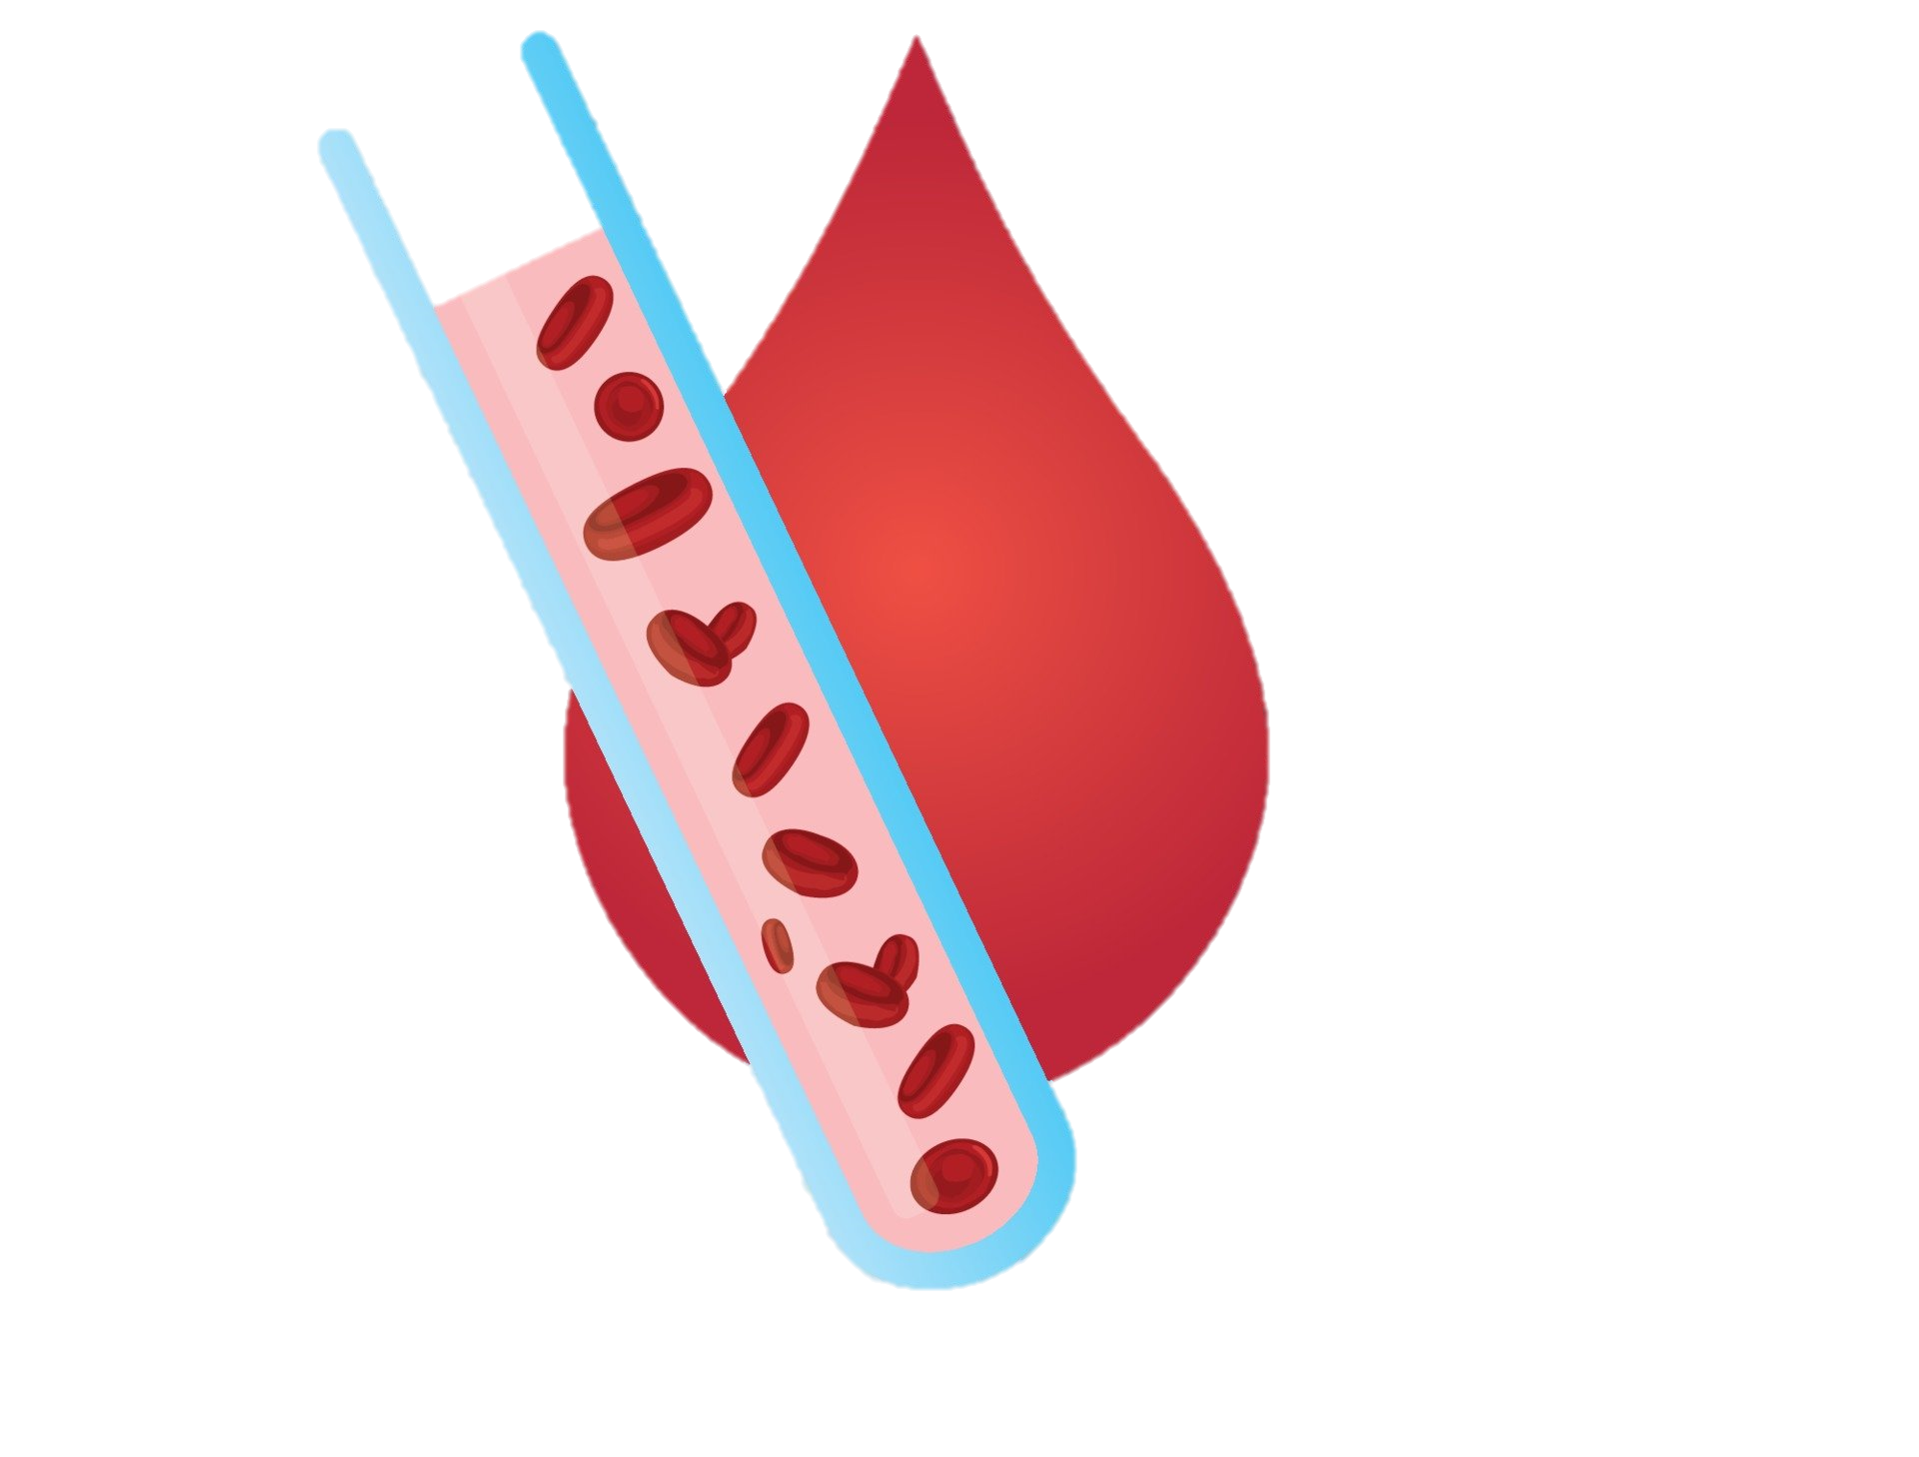
Iron deficiency anemia and the role of Ferric maltol

Slide 2
Anemia
Anemia means ‘pale’ or ‘without blood’
Anemia is defined when the hemoglobin level is reduced to the lower limit of the normal physiological range for the age and sex of the individual.
World Health Organization(WHO) definitions for anemia is-
Sex | Hb level
Adult males | Hb<13 g/dL
Adult non-pregnant females | Hb<12 g/dL
Pregnant females | Hb<11 g/dL
Ref: WHO Global Anaemia estimates, 2021 Edition

Slide 3
Severity of Anemia
Severity of Anemia | Hb level for men (g/dl) | Hb level for Non-pg women (g/dl) | Hb level for pg women (g/dl)
Mild | 11-12.9 | 11-11.9 | 10-10.9
Moderate | 8-10.9 | 8-10.9 | 7-7.9
Severe | < 8.0 | <8 | <7
"Mild" is a misnomer: iron deficiency is already advanced by the time anaemia is detected. The deficiency has consequences even when no anemia is clinically apparent.
Ref:WHO. Haemoglobin concentrations for the diagnosis of anaemia and assessment of severity. Vitamin and Mineral Nutrition Information System. Geneva, World Health Organization, 2011 (WHO/NMH/NHD/MNM/11.1)

Slide 4
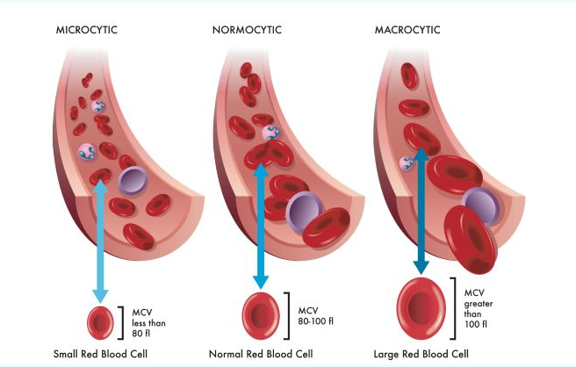
Types of anemia
Physiological anemia of pregnancy
Pathological anemia-
        Microcytic anemia: MCV < 80 fL
        Normocytic anemia: MCV 80-100 fL
        Macrocytic anemia: MCV > 100 fL
MCV-Mean corpuscular volume, measures red blood cell size.
A typical adult MCV level is 80–100 femtoliters (fl).
Ref:Newhall et al. General overview of anaemia management, The Netherlands Journal of Medicine, APRIL 2020, VOL. 78, NO. 3

Slide 5
Types of anemia
    Microcytic anemia
                Iron deficiency
                Hemoglobinopathies(Thalassemia)
                Anemia of chronic disease(in later stage)
                Sideroblastic anemias
    Normocytic anemia
                Anemia due to acute /chronic hemorrhage
                Anemia of chronic disease (ACD)
                Secondary to another disorder such as renal failure, hypothyroidism, multiple myeloma.
                Aplastic anemia
    Macrocytic anaemia
                Folic acid deficiency
                Vitamin B12 deficiency
                Anti-folate drugs (e.g., methotrexate, anti-convulsants )

Slide 6
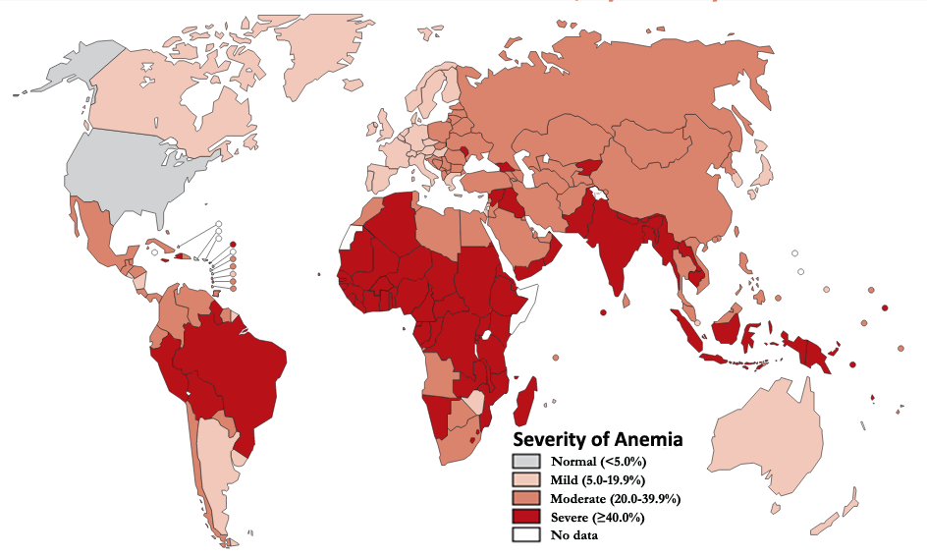
Epidemiology
1/4th
of world population is anemic.
&
½ of this burden is a result of Iron Deficiency.
Ref-1.Worldwide prevalence of anaemia, WHO Vitamin and Mineral
2. Nutrition Information System, 1993–2005

Slide 7

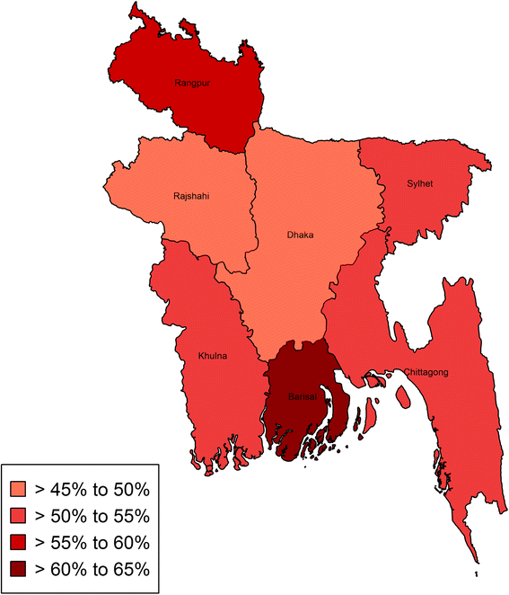
Epidemiology
In Bangladesh,
46.8% population is anemic.
36.7% women of child bearing age and 42.20% of pregnant women are suffering from iron deficiency anemia
Iron Deficiency Anemia stands for 13.6% of it
Ref: WHO Global Anaemia estimates, 2021 Edition

Slide 8
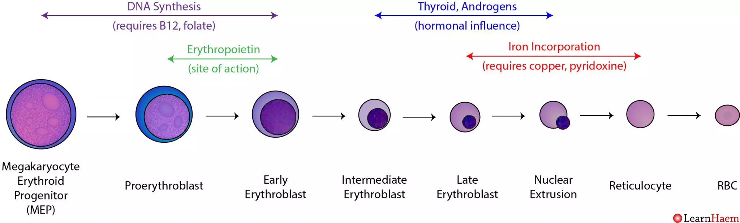
Erythropoiesis
Erythropoiesis is the process of the origin, development and maturation of erythrocytes.
Site-Red bone marrow in adult
Requires folate, vit B12,zinc

Slide 9
Factors required for erythropoiesis
Minerals
Iron
Zinc
Cobalt
Copper
Hormones :
Erythropoietin
Androgens
Thryoxine
Vitamins :
Folic acid
Vitamin B12
Vitamin C
Pyridoxine (B6)
Riboflavin
Vitamin A

Slide 10
Folic acid
Erythroblasts require folic acid for proliferation during their differentiation.
Deficiency of folic acid inhibits purine and thymidylate syntheses, impairs DNA synthesis, and causes erythroblast apoptosis, resulting in anemia from ineffective erythropoiesis.
Periconceptional folic acid supplementation protects against fetal structural anomalies, including NTD, congenital heart defects and prevent preterm birth.
RDA- 400 mcg in periconceptional period.
NEW INSIGHTS INTO ERYTHROPOIESIS: The Roles of Folate, Vitamin B12, and Iron: Mark J. Koury, Prem Ponka-Annual Review of Nutrition,Vol. 24:105-131

Slide 11
Zinc
Zinc is considered as an essential factor for erythropoiesis in addition to iron, folate, and vitamin B12. It is an important co-factor for an enzyme that synthesizes heme portion of the hemoglobin.
Studies have indicated that anemia is significantly associated with zinc deficiency, especially in pregnant women and preschool children.
Zinc in combination with iron supplementation was found to increase hemoglobin levels to a higher extent than iron alone in patients with iron-induced anemia.
RDA-
Men- 11mg
Women-8 mg
Pregnancy-11 mg
Lactation-12 mg
Role of Zinc and Copper in Erythropoiesis in Patients on Hemodialysis, Akira Takahashi, MD, PhD @ 2022 The Authors. Published by Elsevier

Slide 12
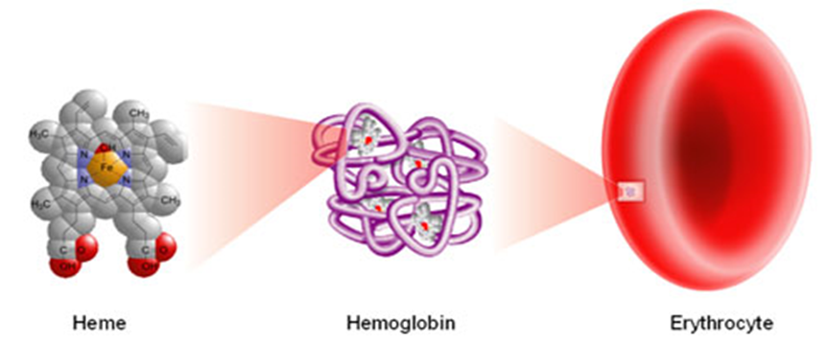
Iron
Iron is an essential element for almost all living organisms as it participates in a wide variety of metabolic processes, including oxygen transport, DNA synthesis, and electron transport.
Iron helps to:
Form and oxygenate blood cells and hemoglobin
Convert food to energy
Maintain a normal immune system
Maintain normal cognitive function

Slide 13
Iron RDA & sources
Target group | RDA
Adult males or postmenopausal females | 8 mg
Menstruating female | 18 mg
During Pregnancy & postpartum period | 30-60 mg
Infants and young children (6–23 months of age) | 10–12.5 mg
Preschool-age children (24–59 months of age) | 30 mg
School-age children(5–12 years of age) | 30–60 mg ( Increased iron demand in growing age)
Iron sources:
Heme iron (2-3X more absorbable): Animal source like meat, fish, and poultry.
Non-heme iron: vegetables, fruits, dried beans, nuts, grain products, and dietary supplements

Slide 14
Iron Homeostasis
Total amount of iron in body is 4-5 gm
                About 2.5 gm iron is found in Hemoglobin.
                About 2 gm iron is stored as Ferritin/Hemosiderin in bone marrow, liver, and spleen
                400 mg is devoted to cellular proteins.
                Only 3–4 mg circulates through the plasma via transferrin.
Iron is preserved in the body by recycling from broken-down red blood cells ( by reticuloendothelial system) into the bone marrow and reutilization for hemoglobin production.
Total iron loss per day (intestine, urine, sweat) is probably less than 1 mg, which is easily replaced by the diet (1.5–2 mg/day).
Truswell, A. Stewart (2010-07-15). ABC of Nutrition. John Wiley & Sons. p. 52. ISBN 9781444314229.

Slide 15
Iron Homeostasis
Ferroprotein is the key iron exporter expressed on macrophages and duodenal enterocytes that allows the recycling of iron from broken down/senescent erythrocytes into plasma and the absorption of iron from the gut into circulation, respectively.
Iron absorption and tissue iron availability are closely regulated by hepcidin. Hepcidin is a protein produced predominantly by hepatocytes, and it exerts control over systemic iron homeostasis by degrading ferroprotein.
Hepcidin expression is increased by high body iron levels and inflammation and decreased by erythropoiesis, hypoxia, and ID.
Truswell, A. Stewart (2010-07-15). ABC of Nutrition. John Wiley & Sons. p. 52. ISBN 9781444314229.

Slide 16
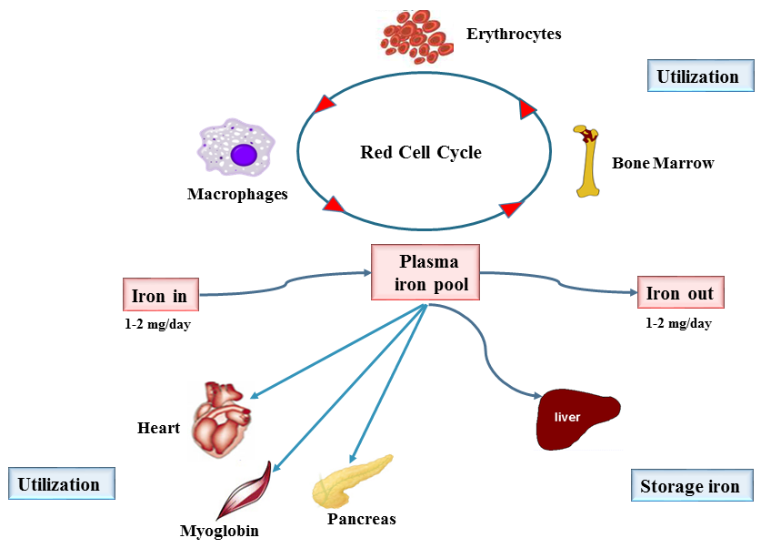
Reticulo-endothelial system

Slide 17
Facts of Iron homeostasis
About 0.8% of circulating red blood cells are destroyed daily. Thus, the quantity of hemoglobin removed and replaced is approximately 7.65 g each day, corresponding to 26 mg of iron.
0.3 mg hemoglobin is lost in per ml blood loss.
Iron requirements increase dramatically during growth, menstruation, pregnancy, blood loss and anemia.
Rate of absorption depends on iron requirement and availability at absorption site.
Iron is best absorbed as ferrous (Fe2+) form in the duodenum, and to a smaller extent in jejunum
Gastric acid/ascorbic acid increases iron absorption whereas phytates (in bran), tannins/polyphenols (in tea), and calcium (in dairy product) decreases absorption.
Ref: Gropper, Sareen S.; Smith, Jack L. (2013). Advanced Nutrition and Human Metabolism (6th ed.). Belmont, CA: Wadsworth. p. 481. ISBN 978-1133104056.
Truswell, A. Stewart (2010-07-15). ABC of Nutrition. John Wiley & Sons. p. 52. ISBN 9781444314229.

Slide 18
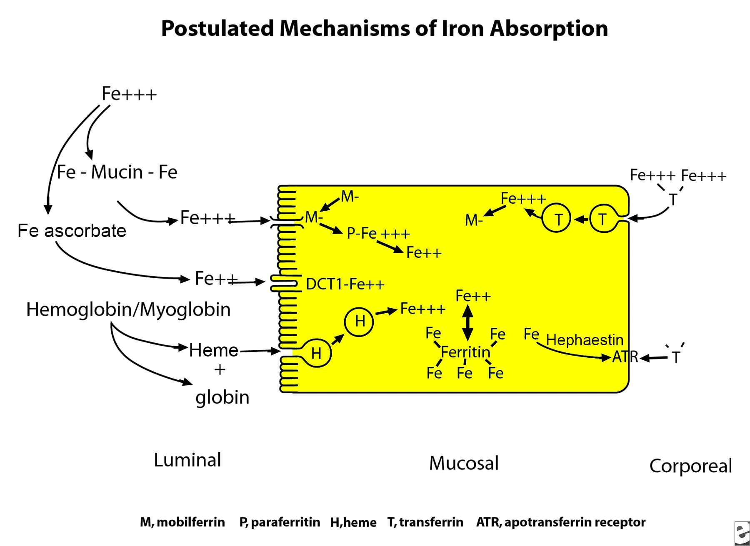
Iron uptake in the proximal small intestine occurs by 3 separate pathways. These are the heme pathway and 2 distinct pathways for ferric and ferrous iron.
Heme iron is enzymatically digested free of globin in the intestinal lumen and enters the absorptive cell as an intact metalloporphyrin.
Ferric iron is absorbed via a b3 integrin and mobilferrin (IMP) pathway that is not shared with other nutritional metals.
Ferrous iron uptake is facilitated by Divalent Metal Transporter 1 (DMT-1) pathway.
Notes:
Ref: American Journal of Hematology 64:287–298 (2000) (Iron Absorption and Transport—An Update) & https://emedicine.medscape.com/article/202333-overview#:~:text=The%20total%20body%20iron%20in,(20%2D25%20mg).

Slide 19
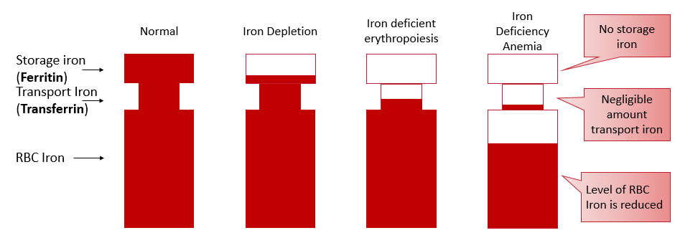
Iron deficiency anemia
IDA is defined as Anemia with biochemical evidence of iron deficiency based on following laboratory findings –
            Total plasma iron
            Serum ferritin
            Total iron binding capacity (TIBC)
            Transferrin saturation

Slide 20
Etiology/Risk Factor
Increased Demand
  Pregnancy
  Childhood/Adolescence
Increased Loss
  Menorrhagia
  Peptic Ulcer
  Hookworm infestation
  GI hemorrhage/Bleeding hemorrhoids
  Acute hemorrhage
  Bleeding disorder
  Blood donation
Decreased Availability
Poor Intake
  Malnutrition
  Diet (Vegetarian)
Poor Absorption
  Chronic use of Antacid/PPI
  GERD/Gastritis
  High consumption of Caffeine/tea
  Celiac disease
  Gastric bypass surgery
  Parasitic/H. pylori infection

Slide 21
Management of Iron deficiency anemia
History Taking
Physical examination
Laboratory Investigations
Treatment

Slide 22
History Taking
Symptoms | History of-
Pale or yellowish skin Fatigue Weakness Headache Dizziness/ lightheadness Shortness of breath Irregular heartbeats Chest pain Cold hands/ feet Dysphagia | Blood loss Blood donation Poor intake Menorrhagia Pre-existing diseases like IBD, peptic ulcer, hemorrhoids, bleeding disorders etc.

Slide 23
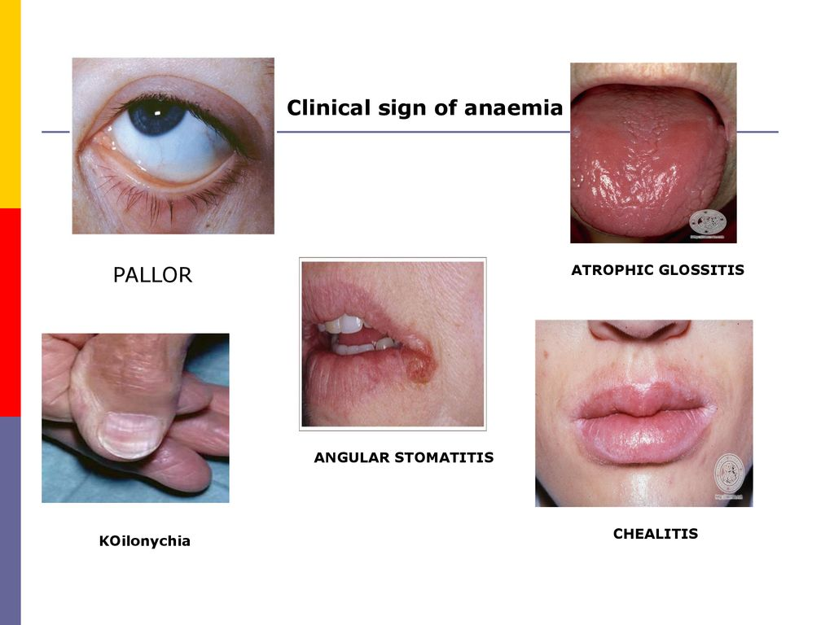
Physical examination
Signs-
Pallor
Atrophic glossitis
Koilonychia
Tachypnea
Tachycardia
Angular stomatitis

Slide 24
Investigations
Hematological Indices | IDA
Hb | Low
Hematocrit | Low
MCV | Low
MCH | Low
MCHC | Low
RDW | High
CBC & Hb-most common
PBF-Features of microcytic hypochromic anemia are found.
Optional-
Serum ferritin
Total iron binding capacity (TIBC)
Transferrin saturation
Transferrin receptor
Bone marrow study (if needed)
Iron studies | IDA
S. Iron | Normal/decreased
Ferritin | Normal/decreased
TIBC | Increased
Transferrin saturation | <20%

Slide 25
Differential Diagnosis
Iron studies | IDA | Anemia of Chronic Disease | Thalassemia | Sideroblastic Anemia
MCV | Low | Low | Low | Low/Normal
S. Iron | Low | Low | Normal | Normal
Ferritin | Low | Normal/High | Normal | Horma
TIBC | Raised | Normal | Normal/low | Normal
Transferrin saturation | <20% | Low | Raised | Normal
Reticulocyte Count | Low | Low/Normal | Normal/Raised | Normal/Raised
RDW | High | Normal | Normal | High
Hemoglobinopathies(Thalassemia)
Anemia of chronic disease(in later stage)
Sideroblastic anemias

Slide 26
IDA due to menstrual disorder
Heavy menstrual bleeding (HMB) is estimated to affect approximately 18–38% of women of reproductive age and may increase in prevalence for women approaching menopause.
With an average menstrual cycle of 29 days and a mean hemoglobin content of 12.8 g/dl the average iron loss was estimated to be about 0.55 mg/day. In HMB the loss is more severe.
Women with HMB lose on average 5-6 times more iron per menstrual cycle than women with a normal blood loss, resulting in totally depleted iron stores and IDA.
A Review of Clinical Guidelines on the Management of Iron Deficiency and Iron-Deficiency Anemia in Women with Heavy Menstrual Bleeding: November 27, 2020

Slide 27
IDA in Pregnancy
Hb cut off values during pregnancy
During early pregnancy, body needs extra 35% iron to produce extra RBC.
40 % of Women enter pregnancy without enough iron
90% do not get enough iron during pregnancy
26% of women are iron deficit after one week of delivery
Gestational period | Hemoglobin (g/dl) | Hematocrit level (%)
1st trimester | <11 | <33
2nd trimester | <10.5 | <31
3rd trimester | <10.5-11 | <33
Postpartum | <10 | <30
Iron Deficiency and Iron Deficiency Anemia: Implications and Impact in Pregnancy, Fetal Development, and Early Childhood Parameters,2020

Slide 28
IDA in Pregnancy
Factors related to IDA in pregnancy-
            Increased fetal demand
            Decreased intake
            Multiparity
            Low birth spacing
            Early pregnancy
            Hyperemesis gravidarum
            Pre-pregnancy anemia

Slide 29
Complications of IDA in pregnancy
During Pregnancy
-Preeclampsia
-Intercurrent infection
-Heart failure
-Preterm labor
During Labor
-Uterine inertia
-Postpartum hemorrhage
-Cardiac failure
-Shock
During Puerperium:
-Puerperal sepsis
-Subinvolution
-Poor lactation
-Puerperal venous thrombosis
-Pulmonary embolism
Effects on baby
-IUGR
-Low birth weight
-Poor cognitive functions
-Increased perinatal loss
Iron Deficiency and Iron Deficiency Anemia: Implications and Impact in Pregnancy, Fetal Development, and Early Childhood Parameters,2020

Slide 30
Treatment
Oral/Parenteral iron supplements
Common Side effects of
Oral iron-
-Nausea
-Vomiting
-Constipation
-Abdominal cramping
-Diarrhoea
Reasons of failure to respond
- Noncompliance
- Concomitant folate deficiency
- Continuous loss of blood through hookworm infestation or bleeding hemorrhoids
Co-existing infection
Faulty iron absorption
Inaccurate diagnosis

Slide 31
Unmet needs in treating IDA with oral iron
It takes ≥3 months to replenish iron store after initiation of oral iron therapy
Iron salts that undergoes chelation and oxidation reduces the absorption of elemental iron.
2-3 daily doses for 2-3 months reduces the patient compliance and treatment adherence.
Oral iron with well tolerability is desired.
A stable iron salt is required for better absorption.
Faster rise in hemoglobin with convenient dosing option is required.

Slide 32
Unmet needs in treating IDA with oral iron
Unabsorbed irons produce free radicle during its absorption which causes cellular damage.
Conventional iron forms insoluble iron complex in alkaline pH of intestine which precipitate iron overload
Safer preparation for long term use is needed.
A stable iron salt is required for better absorption.

Slide 33
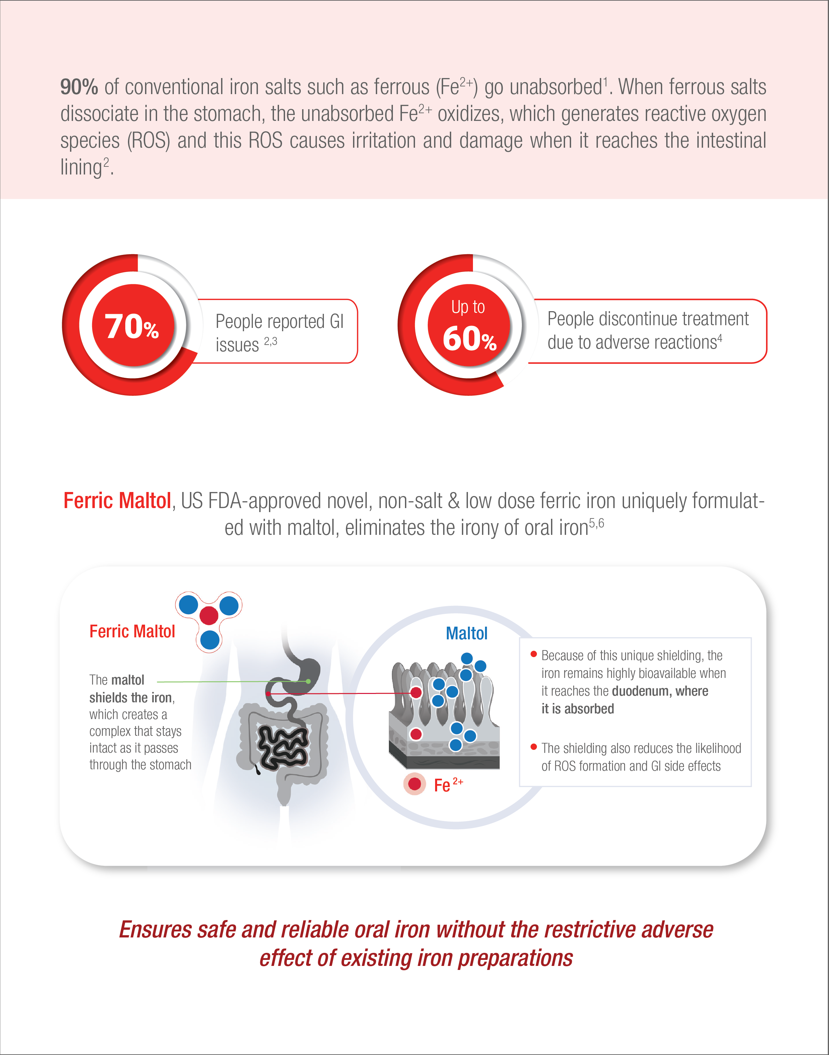
Ferric Maltol

Slide 34
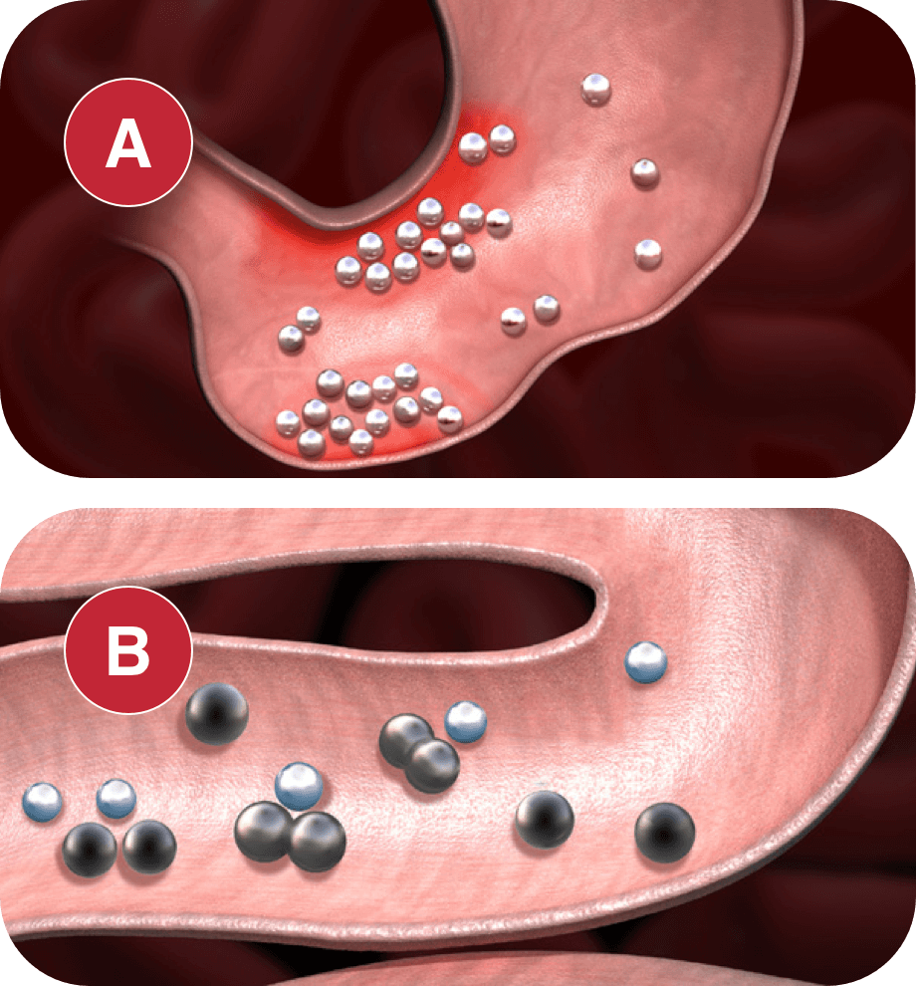
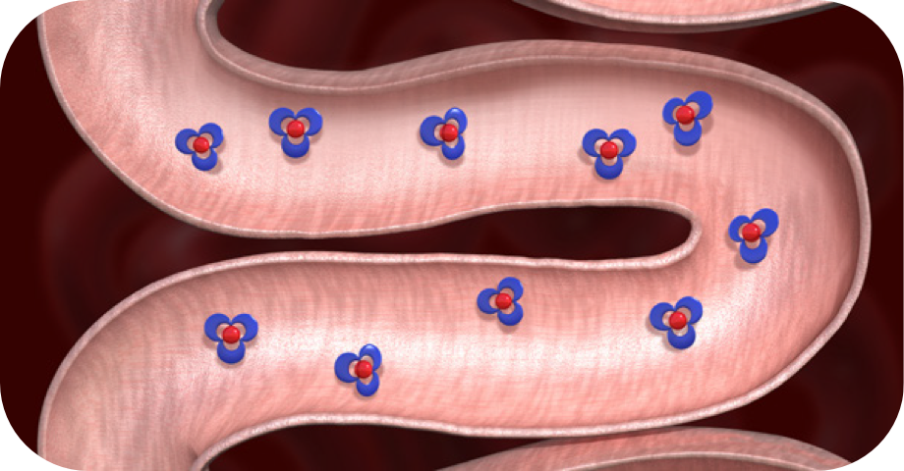
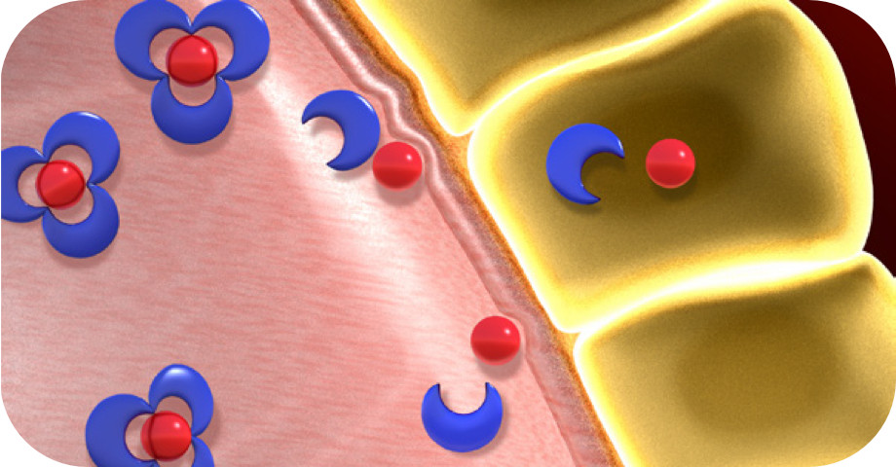
How Ferric Maltol Works(Cont.)
Mechanism of Ferric Maltol
Ferric Maltol passes through the stomach, as tightly bonded chelate .
Ferric Maltol also remain strongly chelated in the intestinal lumen until it reach at the point of absorption.
Iron Transport Receptor on the surface of luminal enterocytes promotes dissociation of iron from maltol.
N.B.: Maltol is separately absorbed, metabolized, and rapidly eliminated in the urine. Unabsorbed iron remains chelated in the iron–maltol complex until excretion in the feces, thereby potentially reducing the risk of intestinal damage from free iron.

Slide 35
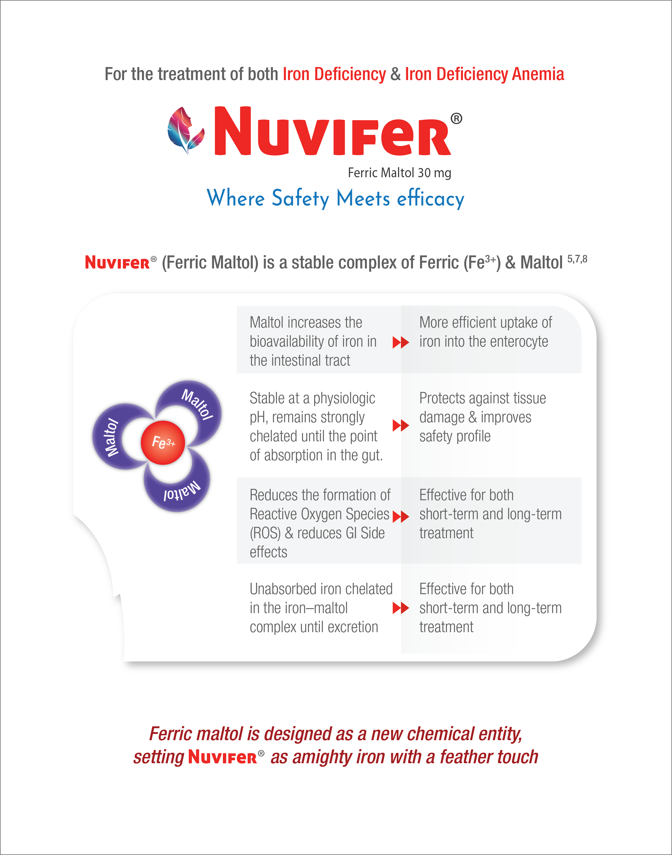
Limitation of Traditional Oral Iron Such as Ferrous Salts (Fe²⁺)
Notes:
Traditional oral iron is widely available, but it just makes most people feel worse. This is because when traditional oral irons break down in the stomach, most of the iron can’t be absorbed. The leftover iron creates molecules that can irritate digestive system. When a treatment is just making feel worse, it can be hard to keep taking it.

Slide 36
PHARMACOLOGY
Absorption: Ferric Maltol dissociates in the gastrointestinal tract, leading to a Tmax of 1.5-3.0 hours for iron concentrations. Mean serum iron increases by 14±6 μmol/L in iron deficient patients following a single dose.
Distribution: 60mg dose is approximately 14% bioavailable. 60 minutes after ingestion of radio-labelled ferric maltol, 11+2% of the dose is present in the bone marrow, 18±1% is present in the liver, and 2.6±1% is in the urine.
Metabolism: In vitro, ferric maltol metabolism is predominantly glucuronidation of Maltol by UGT1A6 and sulfation.
Elimination: 39.8-60% of an oral dose of ferric maltol is excreted in the urine as a glucuronide conjugate. Iron and ferric maltol are not excreted in the urine and unabsorbed ferric Maltol is eliminated in the feces.
Toxicity:It has a wide therapeutic index as patients generally take 30mg twice daily, while concentrations of 20mg/kg may produce toxicity.

Slide 37
SIDE EFFECTS
Flatulence
Nausea
Diarrhea
Vomiting
Constipation
Abdominal pain
Discolored feces
Abdominal discomfort, pain and distension

Slide 38
CONTRAINDICATIONS
Hypersensitivity to the active substance or to any of the excipients
Reactions could include shock, clinically significant hypotension, loss of consciousness, and/or collapse.
Hemochromatosis and other iron overload syndromes
Concomitant use in patients receiving repeated blood transfusions may result in iron overload

Slide 39
WARNING AND PRECAUTION
Increased Risk of Inflammatory Bowel Disease: Avoid use of this drug in patients with an active inflammatory bowel disease, as there is potential risk of increased inflammation in the gastrointestinal tract.
The following clinically significant adverse reactions are described elsewhere in the labeling:
Increased Risk of Inflammatory Bowel Disease
Iron Overload
Risk of Overdosage in Children Due to Accidental Ingestion

Slide 40
USE IN SPECIFIC POPULATIONS
Pregnancy: Not absorbed systemically as an intact complex following oral administration. Maternal use is not expected to result in fetal exposure to the drug.
Lactation: There are no data on the presence of ferric maltol in human milk, the effects on the breastfed child, or the effects on milk production.
Use in Children and Adolescents : Safety and effectiveness of ferric maltol have not been established in pediatric patients. Accidental overdose of iron-containing products is a leading cause of fatal poisoning in children under 6.
Geriatric Use: Of the 295 patients in the randomized trials of Ferric Maltol, 39% of patients were aged 65 and older, while 23% were aged 75 and older. No overall differences in safety or effectiveness were observed between these patients and younger patients.

Slide 41
OVERDOSE
No data are available regarding overdose of ferric maltol in patients. Acute iron ingestion of 20 mg/kg elemental iron is potentially toxic and 200- 250 mg/kg is potentially fatal. Early signs and symptoms of iron overdose may include nausea, vomiting, abdominal pain and diarrhea. In more serious cases there may be evidence of hypoperfusion, metabolic acidosis and systemic toxicity.
Dosages of ferric maltol in excess of iron needs may lead to accumulation of iron in storage sites leading to hemosiderosis. Periodic monitoring of iron parameters such as serum ferritin and transferrin saturation may assist in recognizing iron accumulation. Do not administer ferric maltol to patients with iron overload.

Slide 42
DRUG INTERACTION
There are no empirical data on avoiding drug interactions between ferric maltol and concomitant oral medication.
Concomitant use of ferric maltol may decrease the bioavailability of some drugs, including mycophenolate, ethinyl estradiol, levothyroxine, ciprofloxacin and doxycycline.
For oral drugs where reductions in bioavailability may cause clinically significant effects on its safety or efficacy, separate the administration of ferric maltol by at least 4 hours.
STORAGE
Protect from light, store below 250 C & dry place. Keep out of the reach of children.

Slide 43
Thank you

